Slide 1
Unit 2
PROGRAM STRUCTURE

Slide 2
What is “C”
C is a high-level and general-purpose programming language that is ideal for developing firmware or portable applications.
C is a general-purpose, high-level language that was originally developed by Dennis M. Ritchie to develop the UNIX operating system at Bell Labs.
C was originally first implemented on the DEC PDP-11 computer in 1972 at at and t dell laboratory .
It is one of the most popular computer languages today because of its structure, high-level abstraction, machine independent feature.
C language was developed with UNIX operating system, so it is strongly associated with UNIX

Slide 3
C is what is called a compiled language. This means that once you write your C program, you must run it through a C compiler to turn your program into an executable that the computer can run (execute).
The C program is the human-readable form, while the executable that comes out of the compiler is the machine-readable and executable form.

Slide 4
C characteristics
Reliability: the program can be depended upon always to do what is supposed to do.
Integrity: this refers to accuracy of the calculations. It should be clear that all the other program enhancement would be meaningless if the calculations were not carried out correctly.
Clarity or readability; it refers to the overall readability of the program, with particular emphasis on its underlying logic. If the program is written clearly, it should be possible for another programmer to follow the logic without effort.

Slide 5
Maintainability: the program will be easy to change or modify when the need arises.
Portability: the program will be transferable to different computer with a minimum of modification.
Any C program can be run in different machine with no modification. Ability to extend itself by adding functions to its library.
Extensible language: it enables the user to add his own function to the C library.

Slide 6
I/O statements
Types of I/O Statements
Formatted I/O
  scanf()
  printf()
Unformatted I/O
  gets()
  puts()

Slide 7
scanf() function:: The function used to get input from the user during execution of program and stored in a variable of specified form is called scanf() function.
Syntax: scanf(“format string”,& variable name);
Types:
Single input scanf(“%d”,&a);
Multiple input scanf(“%d %c %d”, &a,&op,&b);

Slide 8
Assignment statements
An assignment statement gives a value to a variable.
Ex-
x = 5; gives x the value 5.
The value of a variable may be changed.
Ex- if x has the value 5, then the assignment statement
x = x + 1; will give x the value 6.
Syntax Variable = expression;
the variable must be declared;
the variable may be a simple name

Slide 9
Data type
Data type can be defined as the type of data of variable or constant store.
When we use a variable in a program then we have to mention the type of data. This can be handled using data type in c
Int(%d or %i) 2byte
Float(%f) 4
Char(%c) 1
Double(%lf) 8

Slide 10
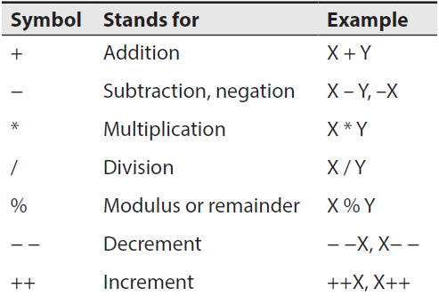
Arithmetic Operators
Arithmetic operators can further be classified as unary operators and binary operators.
Arithmetic operators

Slide 11
Relational Operators
A relational operator is used to compare two values and the result of such an operation is always logical, i.e., either true or false.
Symbol | Stands for | Example
> >= < <= == != | Greater than Greater than equal to Less than Less than equal to Equal to Not equal to | X > Y X >= Y X < Y X <= Y X == Y X != Y

Slide 12
Logical Operators
A logical operator is used to connect two relational expressions or logical expressions.
The result of such an operation is always logical, i.e., either True (1) or False (0). The valid logical operators supported by C are given below:
Symbol | Stands for | Example
&& || ! | Logical AND Logical OR Logical NOT | x && y x || y ! x

Slide 13
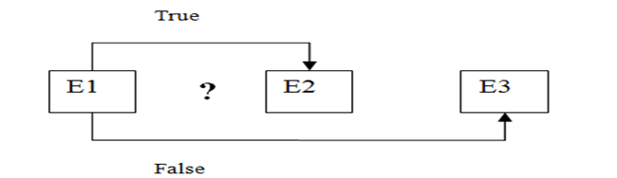
conditional operator
It is represented by the symbols '?' and ':'
E1 ? E2 : E3
where E1, E2 and E3 are expressions.
Expression E1 is tested; if E1 is true then E2 is evaluated; otherwise the expression E3 is evaluated, as shown below:

Slide 14
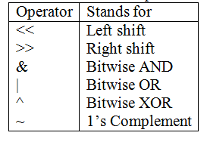
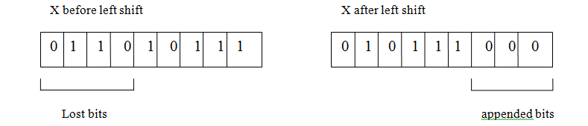
Bitwise Operators
These operators are used for the manipulation of integer data items at bit level.
X << 3

Slide 15
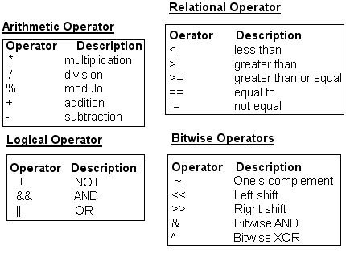
Operators and expression

Slide 16
Control structures
Decision control statement
  if statements
  if else statements
  nested if statements
Loop control statement
  For loop
  While loop
  Do-while loop

Slide 17
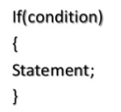
If statement
If statement is a decision making statement.
It is used to control the flow of execution and also used to test logically whether the condition is true or false.

Slide 18
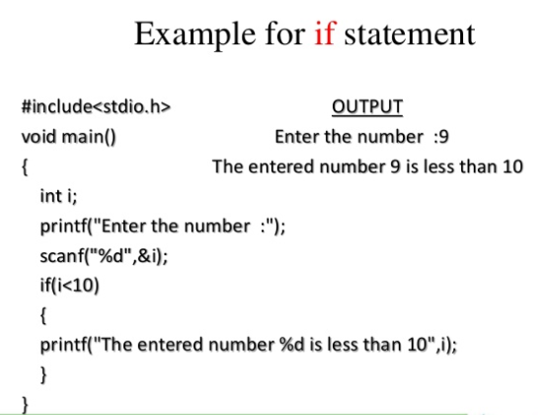

Slide 19
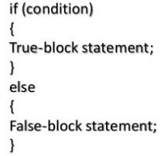
If….else statement
The if…else statement is an extension of the simple if statement.
If the condition is true, then the true-block statement are executed; otherwise the false –block statement are executed.

Slide 20
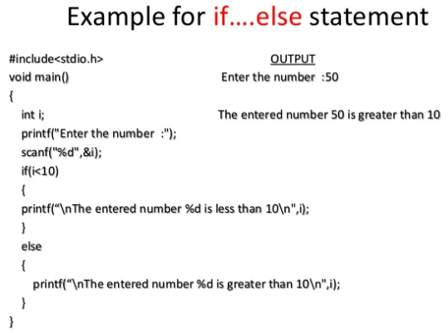

Slide 21
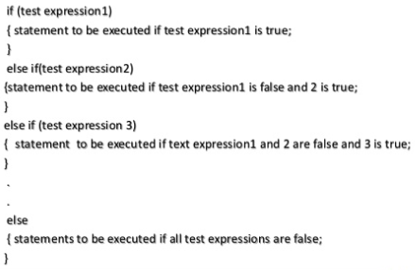
Nested if-else
This is used when program requires more than one test expression.

Slide 22
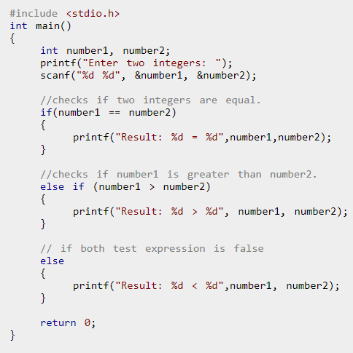

Slide 23
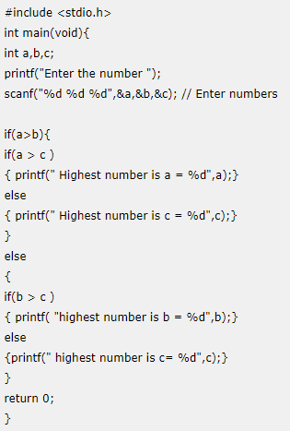
Problems
Program to check whether an integer entered by the user is odd or even.
Check Whether a Number is Positive or Negative
C program to calculate the biggest of 3 numbers
C program to find class
marks is less than 100 and more than 75-1st class
marks is less than 75 and more than 50-2nd class
marks is less than 50 and more than 30-3rd class
Notes:
if (number <= 0.0) { if (number == 0.0) printf("You entered 0."); else printf("You entered a negative number."); } else printf("You entered a positive number.");

Slide 24
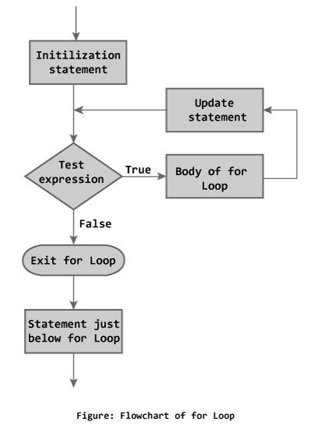
For loop
for (initialization Statement; test Expression; update Statement)
{
// codes
}

Slide 25
For loop
The initialization statement is executed only once.
Then, the test expression is evaluated. If the test expression is false (0), for loop is terminated. But if the test expression is true (nonzero), codes inside the body of for loop is executed and the update expression is updated.
This process repeats until the test expression is false.
The for loop is commonly used when the number of iterations is known.

Slide 26
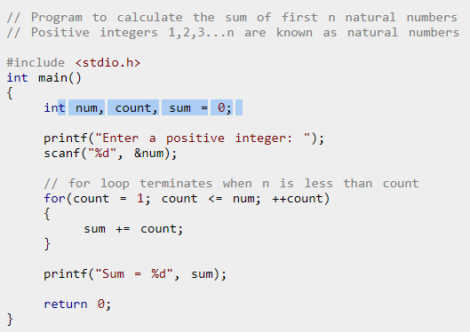

Slide 27
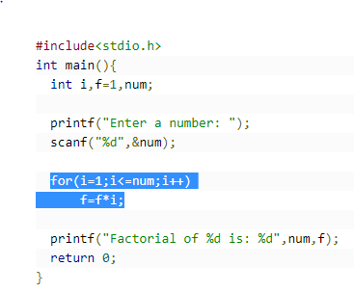
Factorial

Slide 28
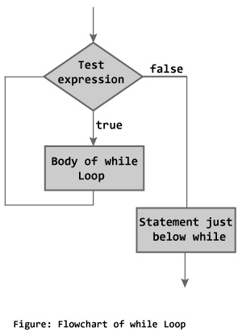
While loop
A while loop in C programming repeatedly executes a target statement as long as a given condition is true.
Syntax
while (test Expression)
{
//codes
}
where, test Expression checks
the condition is true or false
before each loop.

Slide 29
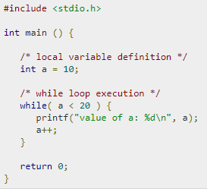
Example

Slide 30
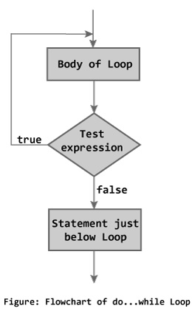
do...while loop
The body of do...while loop is executed once, before checking the test expression. Hence, the do...while loop is executed at least once.
Syntax
do
{
// codes
}
while (test Expression);

Slide 31
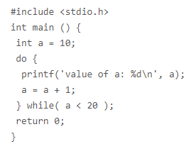

Slide 32
Switch statement
It evaluates an expression, then attempts to match the result to one of several possible cases.
Each case contains a value and a list of statements.
Often a break statement is used a the last statement in each case’s statement list.
A break statement causes control to transfer to the end of the switch statement.

Slide 33
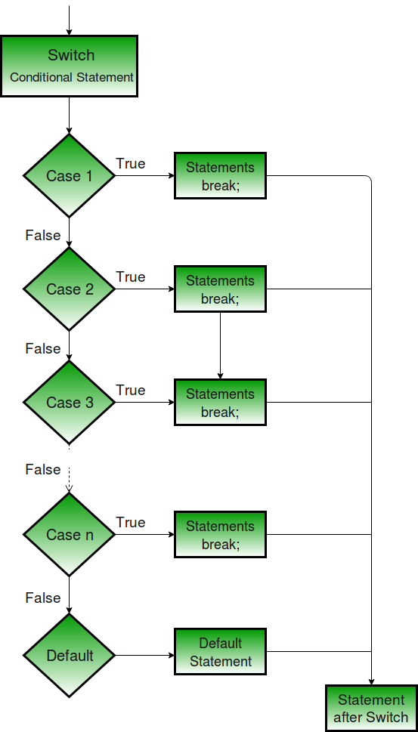
switch (n)
{
case 1: // code to be executed if n = 1;
  break;
case 2: // code to be executed if n = 2;
break;
default: // code to be executed if n doesn't match any cases }

Slide 34
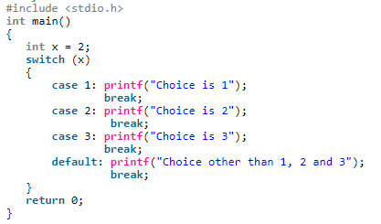
Ex-

Slide 35
problems
Table of any number
Reverse of number
Sum of number

